Slide 1
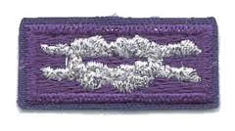
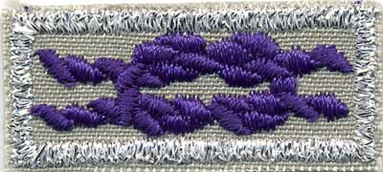
Scouting’s Religious Emblems Program

Slide 2
A Scout is Reverent
Created in 1926 by the BSA to encourage scouts and scouters to grow even stronger in their personal religious beliefs.
Available to all aspects of the Scouting Program
Cub Scouts
Boy Scouts
Varsity
Venturing
Is NOT directly developed by the BSA!

Slide 3
What are the Religious Emblems?
A scout makes the decision to pursue the award
A counselor is selected to guide the scout through the program
The counselor’s qualifications are up to the particular emblem’s governing body (more on this in a few…)
Some programs are one level for all ages, others are age-specific.

Slide 4
Does my faith have an award?
Put simply, yes! There are currently 43 specific denominations with a BSA-recognized program.
May protestant denominations follow the program produced by P.R.A.Y.
Some faiths have produced their own programs, like
Catholicism ̶̶ Moravian Church ̶ Judaism
Buddhism ̶̶ Hinduism ̶̶ Jainism
Islam ̶̶ Latter-Day Saints ̶̶ Unitarian Universalist
Zorastrianim ̶̶ Sikhism ̶̶ Meher Baba

Slide 5
How do we get started?
First, obtain the participant booklet for the denomination you are pursuing.
Review the program with the scout’s parent/guardian.
Find a counselor.
Check with your religious institution FIRST! Show them the booklet, as some groups have specific rules about who can be a counselor.
Work through the booklet to complete the requirements.

Slide 6
We finished! Now what?
Order the presentation package for your particular award
Meet with your religious institution to determine if they will present the award.

Slide 7
Are there adult religious emblems?
YES! But they work a little different
Adult awards are by nomination, so there aren’t any set requirements.
These aren’t BSA awards, but the square knot is approved for wear on the uniform.
You cannot nominate yourself!

